Slide 1
Digital Logic & Design
Lecture 10-12

Slide 2
Boolean Algebra
Variable
Complement
Literal
Notes:
Variable: A variable is a symbol usually an uppercase letter used to represent a logical quantity.
A variable can have a 0 or 1 value.
Complement: A complement is the inverse of a variable and is indicated by a bar over the variable.
Complement of variable X is X*
If X = 0 then X*= 1 and if X = 1 then X*= 0
Literal: A Literal is a variable or the complement of a variable. X and X* are literals

Slide 3
Boolean Addition & Multiplication
Boolean Addition performed by OR gate
Sum Term describes Boolean Addition
Boolean Multiplication performed by AND gate
Product Term describes Boolean Multiplication

Slide 4
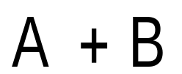
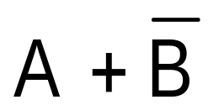
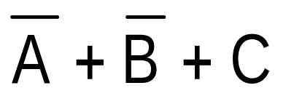
Boolean Addition
Sum of literals
Sum term = 1 if any literal = 1
Sum term = 0 if all literals = 0
Notes:
Sum term is described as sum of literals

Slide 5
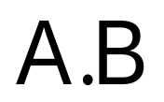
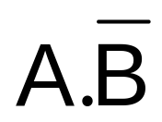
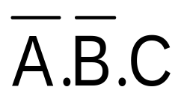
Boolean Multiplication
Product of literals
Product term = 1 if all literals = 1
Product term = 0 if any one literal = 0
Notes:
Product term is described as product of literals

Slide 6
Laws, Rules & Theorems of Boolean Algebra
Commutative Law
  for addition and multiplication
Associative Law
  for addition and multiplication
Distributive Law
Rules of Boolean Algebra
Demorgan’s Theorems

Slide 7
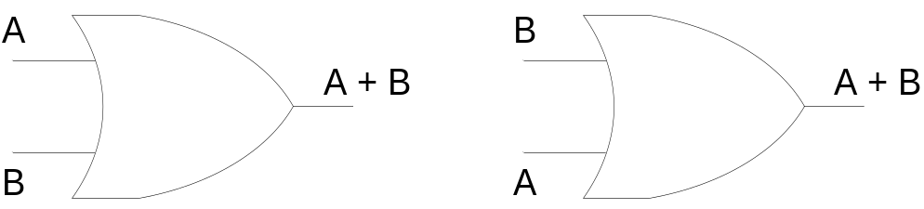
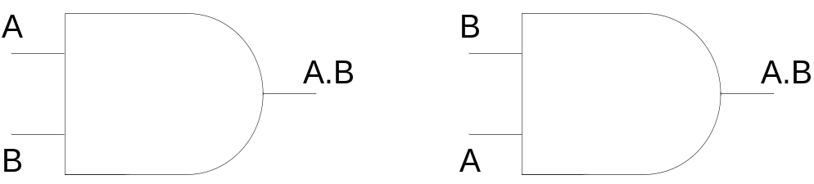
Commutative Law
Commutative Law for Addition
A + B = B + A
Commutative Law for Multiplication
A.B = B.A
Notes:
The basic laws of Boolean Algebra are the same as ordinary algebra and hold true for any number of variables

Slide 8
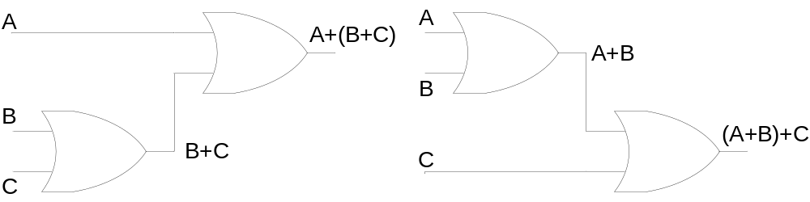
Associative Law
Associative Law for Addition
A + (B + C) = (A + B) + C
Notes:
The sum term B OR C Ored with A is the same as sum term A OR B Ored with C

Slide 9
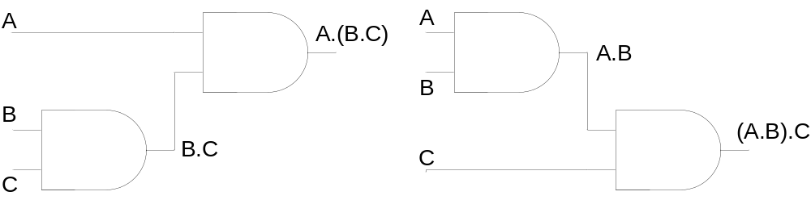
Associative Law
Associative Law for Multiplication
A.(B.C) = (A.B).C
Notes:
The product term BC Anded with A is the same as AB Anded with C

Slide 10
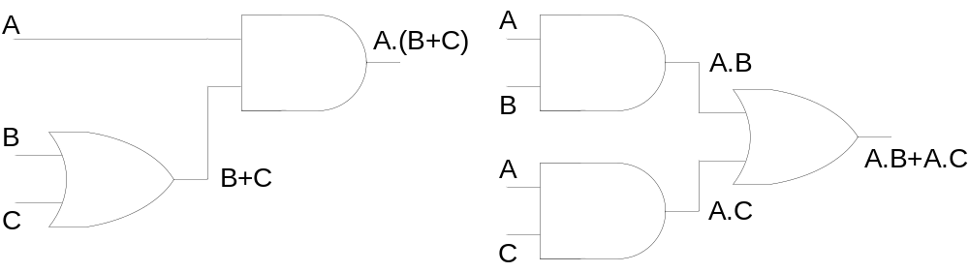
Distributive Law
A.(B + C) = A.B + A.C

Slide 11


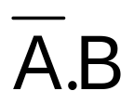

Rules of Boolean Algebra
A + 0 = A
A + 1 = 1
A.0 = 0
A.1 = A
A + A = A
A + = 1
A.A = A
A. = 0
= A
A + A.B = A
A + = A + B
(A+B).(A+C)
= A+B.C → Distributive Law
Notes:
11: A+A’B = A+ AB + A’B = A+ (A+A’)B = A + B using rule 10 & 6 & 4
Or by using Distributive Law A+A’B = (A+A’)(A+B) = 1.(A+B) = A+B
12: (A+B).(A+C) = A.A+AC+AB+BC = A + AC+AB+BC = (A+AB)+AC+BC =( A + AC) + BC = A + BC
(Rules in 12 part)….. 7 & 10 two times because A + AB = A & A +AC = A
13: Consensus Theorem: AB + A’C + BC = AB + A’C
LHS = AB + A’C + BC .(1)= AB + A’C + BC .(A+A’) = AB + A’C + ABC+A’BC = (AB + ABC) + (A’C + A’BC) = AB(1+C) + A’C(1+C) = AB+A’C
13: Transposition Property→ AB +A’C = (A+C).(A’+B) = AA’ + AB + A’C + BC = AB + A’C +BC = AB + A’C (By Consensus Theorem)

Slide 12
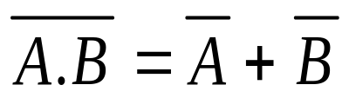
Demorgan’s Theorems
First Theorem
Demorgan’s First Theorem states: The complement of a product of variables is equal to the sum of the complements of the variables.

Slide 13
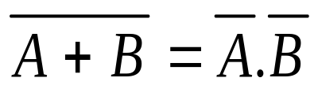
Demorgan’s Theorems
Second Theorem
Demorgan;s Second Theorem states: The complement of sum of variables is equal to the product of the complements of the variables

Slide 14
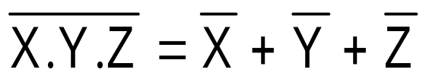
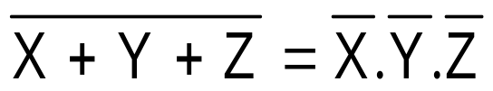
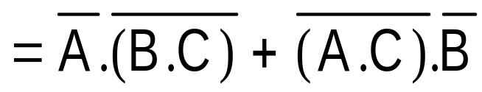
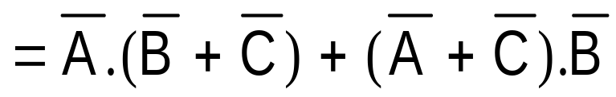
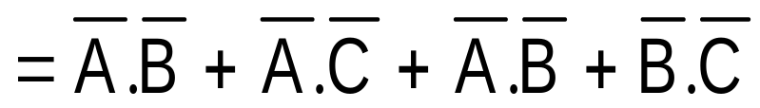
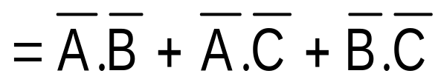
Demorgan’s Theorems
Any number of variables
Combination of variables
Notes:
Demorgan’s Theorems can be applied to expressions having any number of variables
Demorgan’s Theorem can be applied to a combination of other variables

Slide 15
Boolean Function:
Boolean function is composed of binary variables and logical operation symbols.
For given values of variables value of function is either ‘1’ or ‘0’ for example:
F₁= x + y’z
F₁=1 when either x =1 or y’z =1 otherwise ‘0’.
y’z=1 when y=0 and z=1

Slide 16
Boolean Function:
Any Boolean function can also be represented in a truth table. If Boolean function has ‘n’ different variables then truth table will have 2^{n} rows.
x
0
0
0
0
1
1
1
1
y
0
0
1
1
0
0
1
1
z
0
1
0
1
0
1
0
1
F₁
0
1
0
0
1
1
1
1

Slide 17
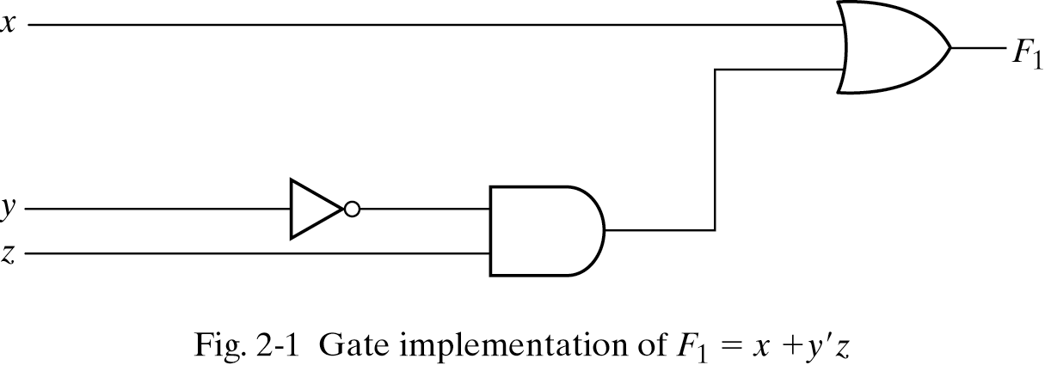
Boolean Function

Slide 18
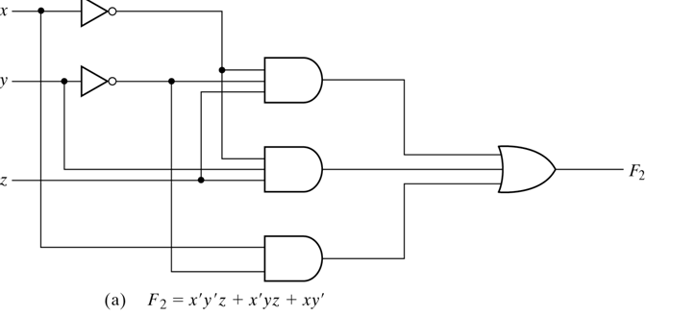
Reducing Boolean Expressions/Functions
F₂=x’y’z + x’yz + xy’
x
0
0
0
0
1
1
1
1
y
0
0
1
1
0
0
1
1
z
0
1
0
1
0
1
0
1
F₂
0
1
0
1
1
1
0
0

Slide 19
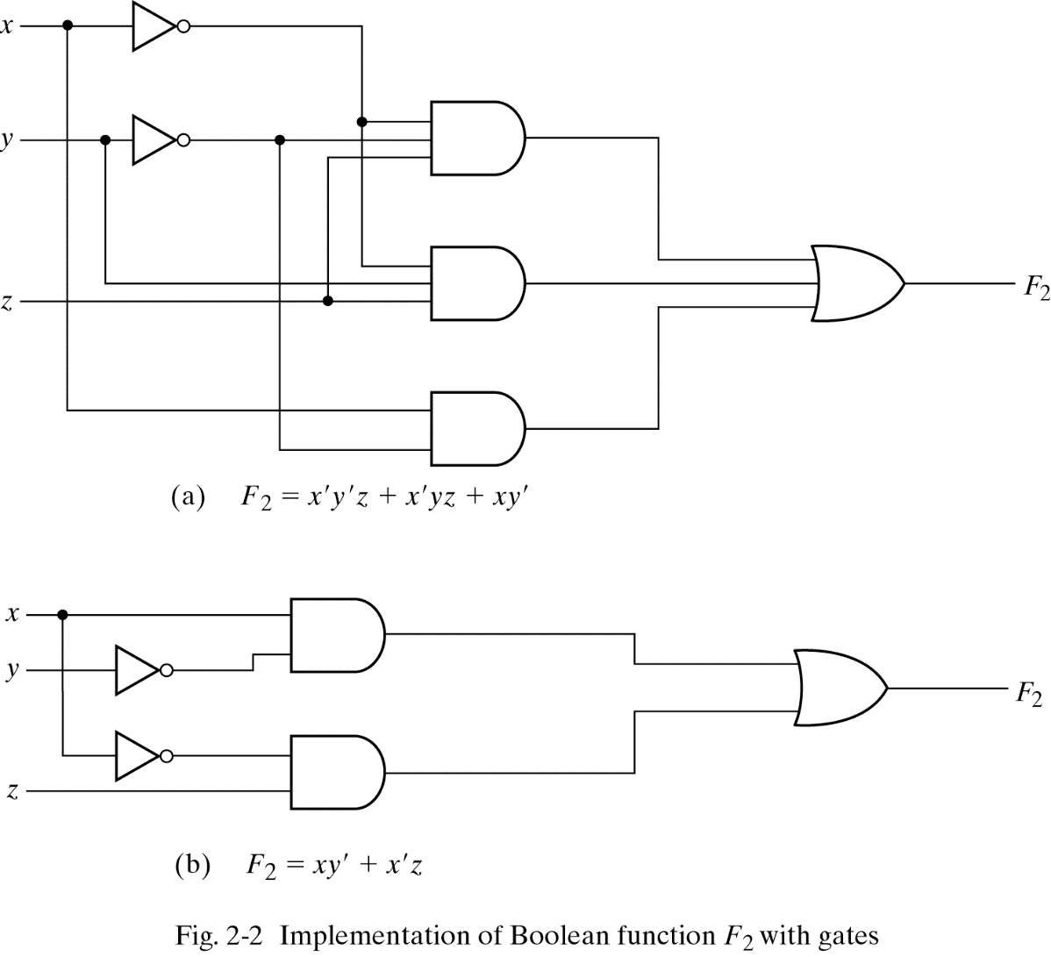
Reducing Boolean Expressions/Functions

Slide 20
Examples:
Simplify the following expressions to a minimum number of literals:

Slide 21
Representation Conversion
Circuit
Boolean
Expression
Truth
Table

Slide 22
Writing of Boolean Expression from Truth Table.
There are two methods to write a Boolean expression from truth table.
Sum of Products (SOP) form/ Sum of minterms
Product of Sums (POS) form / product of maxterms

Slide 23
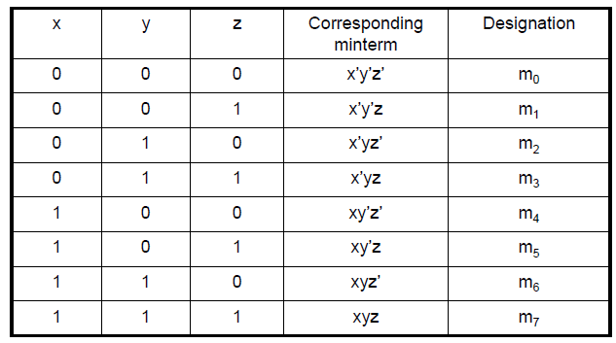
Minterms
A minterm is AND term of variables where each variable appears once either in orignal form or its complement form.
If there are ‘n’ variables in a Boolean expression then there will be 2^{n} minterms.
Consider a case when n=3

Slide 24
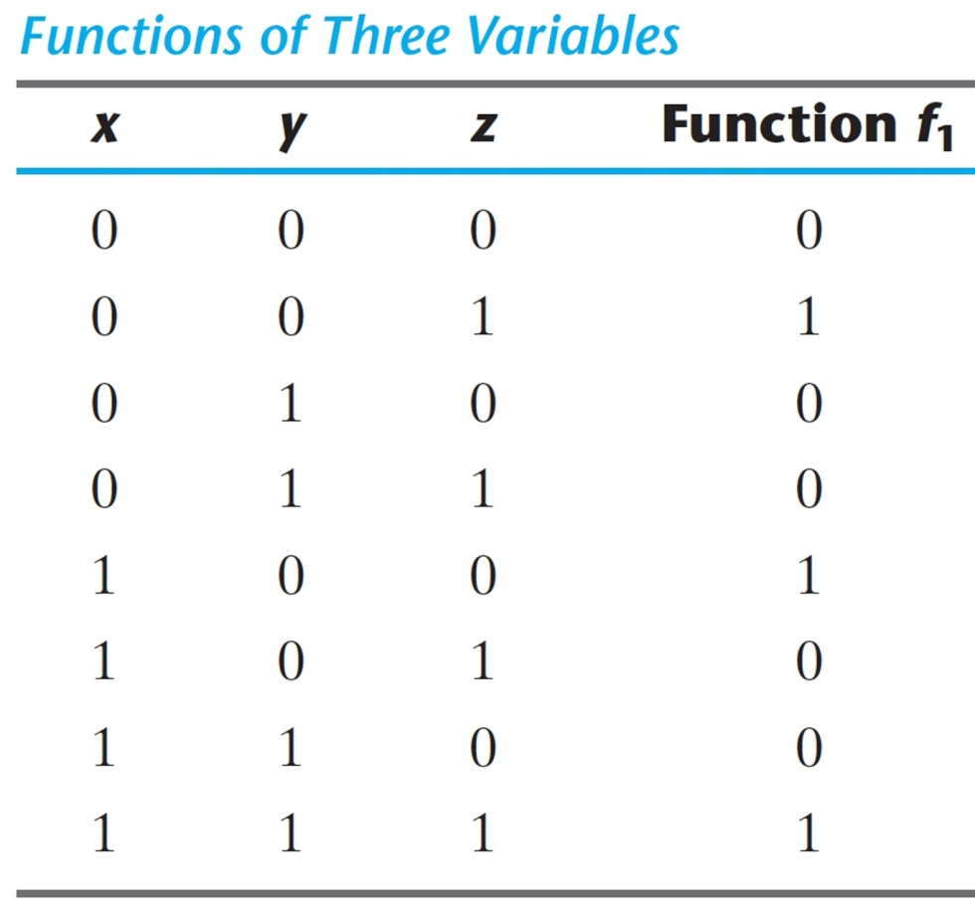
Writing a Boolean Expression as SOP/Sum of minterms from Truth Table:
A Boolean function can be expressed algebraically from a given truth table by:
  Forming a minterm for each combination of the variables that produces a ‘1’ in the function
  Taking the OR of all those terms
Example
f₁ =
x’y’z
+
xy’z’
+
xyz

Slide 25
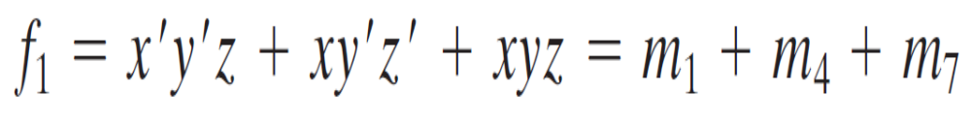
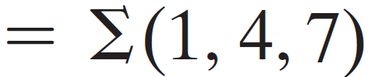
Contd…
Sum of Minterms
Any Boolean function can be expressed as a sum of minterms

Slide 26
Complement in SOP(minterms) Form
Compliment of a Function: from a given truth table by:
  Forming a minterm for each combination that produces a ‘0’ in the function and ORing those terms
Example

Slide 27

Writing a Boolean Expression as SOP/Sum of minterms from Truth Table:
x
0
0
0
0
1
1
1
1
y
0
0
1
1
0
0
1
1
z
0
1
0
1
0
1
0
1
F₁
0
1
0
0
1
0
0
1
F₁’
1
0
1
1
0
1
1
0

Slide 28
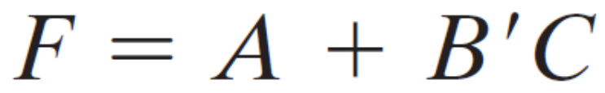
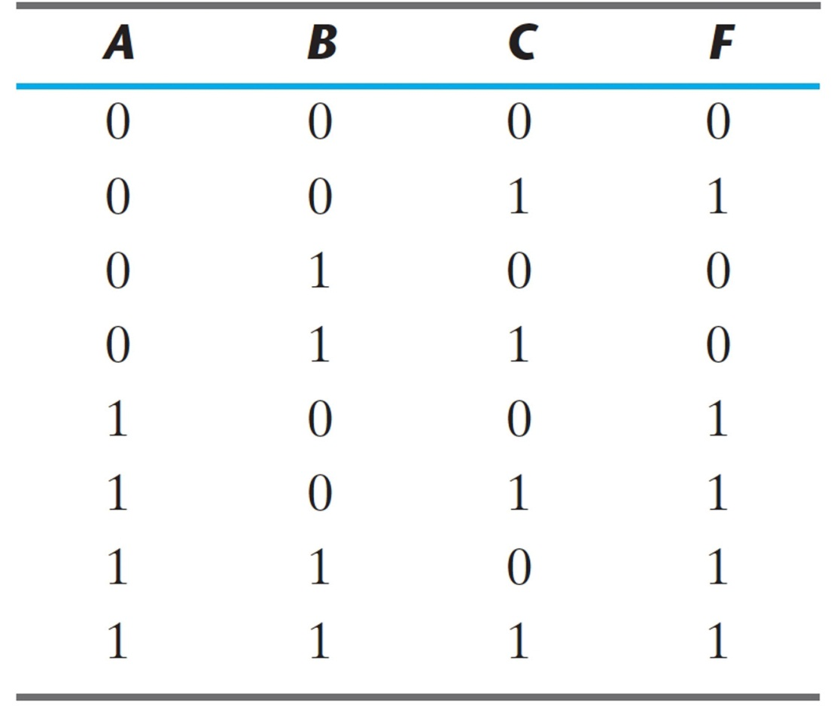
Example
Express the Boolean function as a Sum of minterms:
Method 1

Slide 29
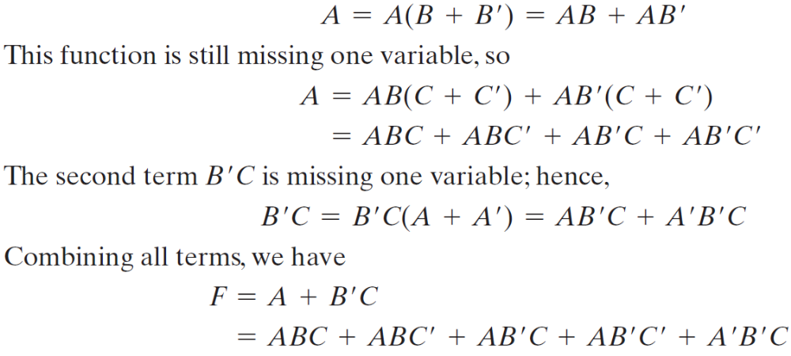
Example
Express the Boolean function as a Sum of minterms:
Using Boolean Algebra
  The function has three variables: A, B, and C
  The first term A is missing two variables (B and C)
  The second term is missing one variable (A)
  Recall: Multiplicative identity = 1 or (x + x’)
Method 2

Slide 30
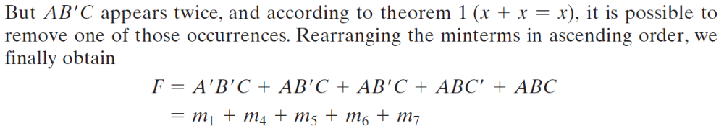
Example
Method 2

Slide 31
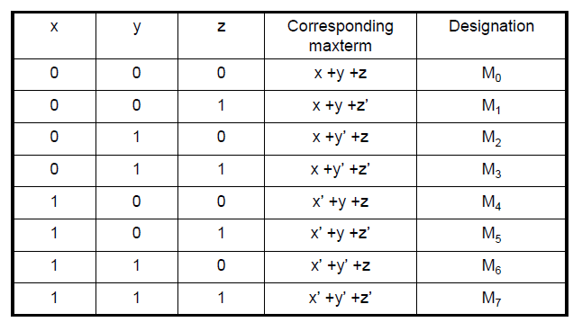
Maxterms
A maxterm is ORED term of variables where each variable appears once either in orignal form or its complement form.
If there are ‘n’ variables in a Boolean expression then there will be 2^{n} maxterms.
Consider a case when n=3

Slide 32

Writing a Boolean Expression as POS/Product of maxterms from Truth Table:
A Boolean function can be expressed algebraically as product of maxterms from a given truth table directly by forming a maxterm for each combination of variables that produces ‘0’ in the function and then ANDing all those terms.
x
0
0
0
0
1
1
1
1
y
0
0
1
1
0
0
1
1
z
0
1
0
1
0
1
0
1
F₁
0
1
0
0
1
0
0
1
F₂
0
0
0
1
0
1
1
1
F₂=(x+y+z)(x+y+z’)(x+y’+z)(x’+y+z)
F₂= M₀ . M₁ . M₂ .M₄

Slide 33
Converting a Boolean Expression into POS/ Product of maxterms
Express the function or expression into ORed terms using Boolean algebra rule A + BC = (A + B)(A + C) : for instance
x + yz = (x+y)(x+z)
Then any missing variable x in each OR term is ORed with xx’

Slide 34
Example:
F = xy + x’z

Slide 35
Canonical Form
Boolean functions expressed as SOP and POS are said to be in canonical form.
In canonical form each minterm and maxterm contain all variables either in original or in complemented form.

Slide 36
Maxterms and Minterms Relationship:
For example:
Minterms
x y z Minterm
0 0 0 x’y’z’ m₀
0 0 1 x’y’z m₁
…
1 0 0 xy’z’ m₄
…
1 1 1 xyz m₇
For example:
Maxterms
x y z Maxterm
0 0 0 x+y+z M₀
0 0 1 x+y+z’ M₁
…
1 0 0 x’+y+z M₄
…
1 1 1 x’+y’+z’ M₇
m_{j}’= M_{j}

Slide 37
Conversion Between Canonical Form
x
0
0
0
0
1
1
1
1
y
0
0
1
1
0
0
1
1
z
0
1
0
1
0
1
0
1
F₁
0
1
0
0
1
0
0
1

Slide 38
Standard Form
Besides canonical form a Boolean function can also be represented as Standard form.
There are two types of Standarsd form;
Sum of product standard form:
F4(x,y,z)= xy + y’z
Product of sum standard form:
F5(x,y,z) = (x + y’)(y + z)

Slide 39
Non Standard Forms
A function may be written in non standard form:
F6 = (xy + z)(xz + y’z)

Slide 40
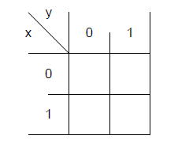
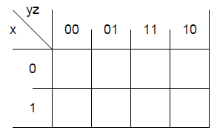
K-Map
Used to simplify the Boolean expressions:
Consist of cells of arrays.
Used to simplify the 2,3,4 and 5 variables expressions.

Slide 41
K-Map
K- map is graphical representation of truth table.
Each cell of K-Map corresponds to one minterm of function.
Adjacent cells differ by one literal i.e x or x’.
Function is plotted by placing the ‘1’ in cells corresponding to
minterms.
Put ‘0’ in rest of cells.

Slide 42
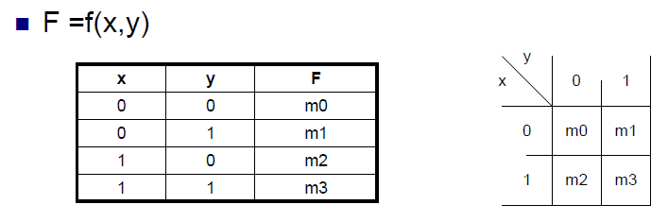
K-Map with 2 Variables
y
x
0
1
x’y’
x’y
0
x
1
xy’
xy

Slide 43
K-Map with 2 Variables
One cell represents a term with two literals
A group of two adjacent cells represent a term with one literal.
A group of four adjacent cells produce a function which is always ‘1’ .

Slide 44
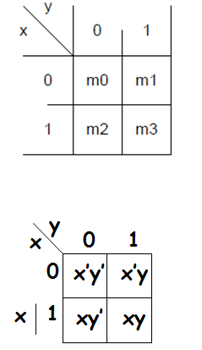

Example:

Slide 45

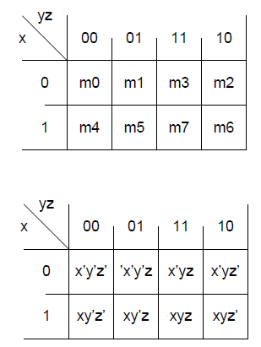
K-Map with 3 Variables

Slide 46
K-Map with 3 Variables
One cell represents a term with three literals
A group of two adjacent cells represent a term with two literals.
A group of four adjacent cells represent a term with one literal.
A group of eight adjacent cells produce a function which is always ‘1’ .

Slide 47

Example:

Slide 48

Example:

